Slide 1
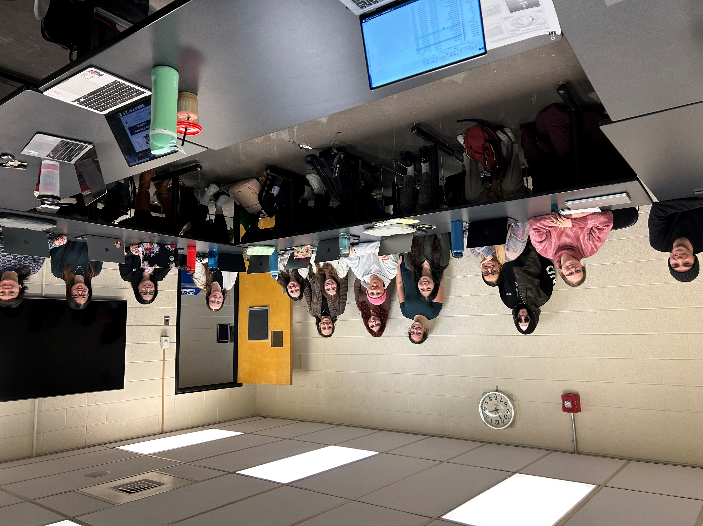



Team 6135: Winter, 2025
Victoria
Vanessa
Marlee
Ashley
Danika
Mina
Yara
Will
Sophie
Audrey
Jessica
Hannah
Sami
Camile
Nisha
Courtney
Iroshini

